Slide 1
Fake Social Media Profile Detection
Present by:
Fatimah Alqahtani
Rawabi Almutiri
Raghad Alsager
Afrah Alsharari
Nov, 2021

Slide 2
TABLE OF CONTENTS
01
02
03
Introducation
Objectives
Methodology
04
05
06
Evaluation
Test model on real account
Future work

Slide 3

Introduction
Social media is apart of our lives
January 2019, 3.484 billion people actively use social media
Who is the influencer?

Slide 4
Objectives
Find out the relationship between the features
Project Idea : Classification of Fake/ not fake accounts using machine learning capabilities
Test the model on real life influencers accounts
Find out the number of followers

Slide 5



TOP SOCIAL NETWORKING SITES in 2020
Source: https://www.adobe.com/express/learn/blog/top-social-media-sites

Slide 6
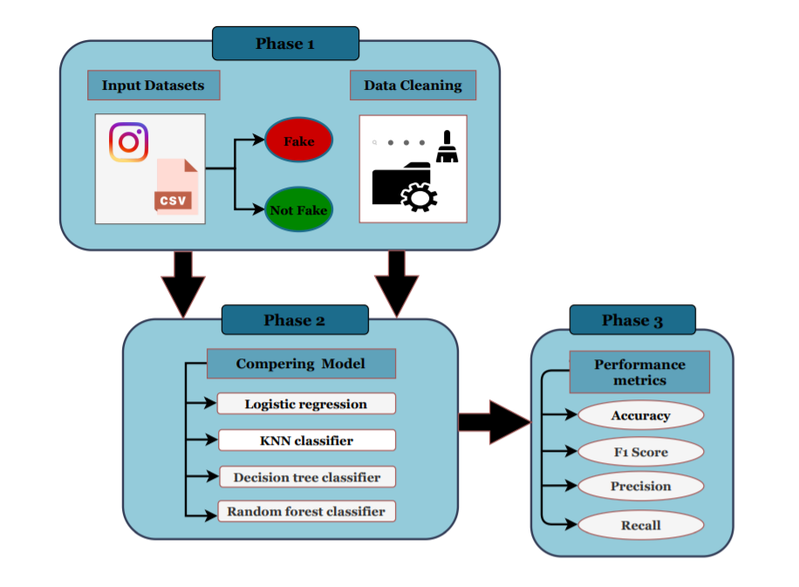
Methodology

Slide 7
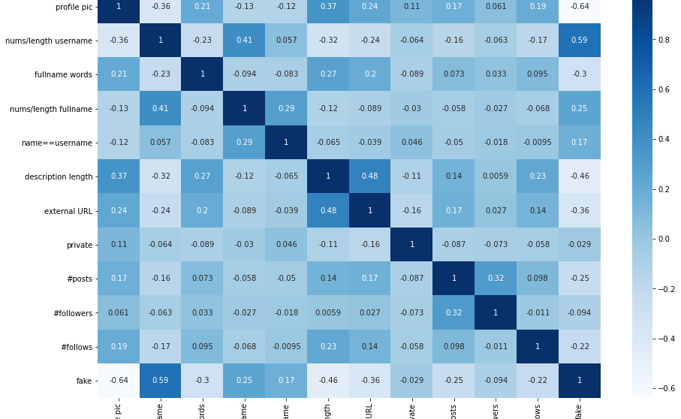
Correlation between features

Slide 8
Evaluation

Slide 9
Accuracy Comparing
Classifier | Accuracy | Precision | Recall | F1-Score
Logistic Regression | 0.908 | 0.95 | 0.876 | 0.912
KNN Classifier | 0.866 | 0.833 | 0.877 | 0.854
Decision Tree Classifier | 0.875 | 0.833 | 0.909 | 0.869
Random Forest Classifier | 0.925 | 0.916 | 0.932 | 0.924

Slide 10
Apply the model on real life account

Slide 11
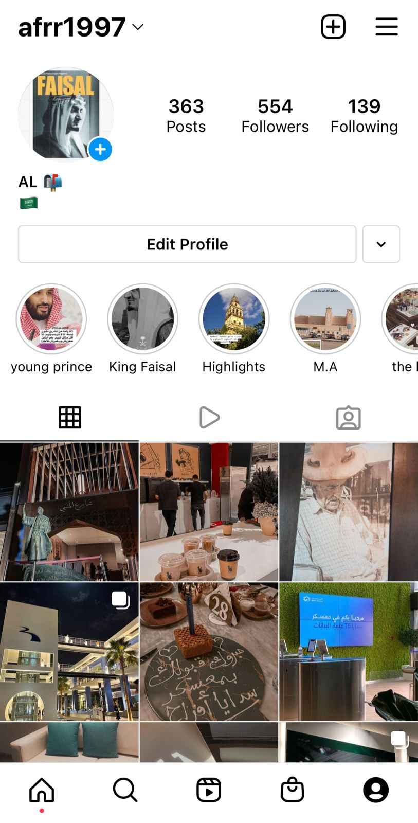
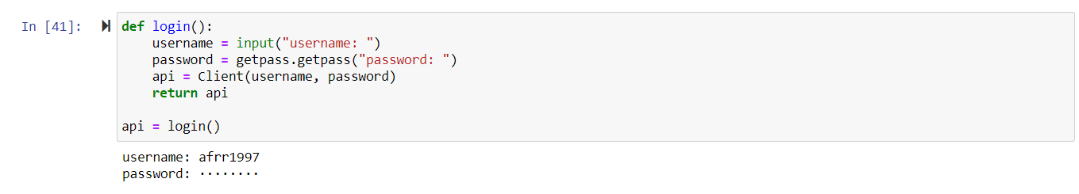
Real account

Slide 12
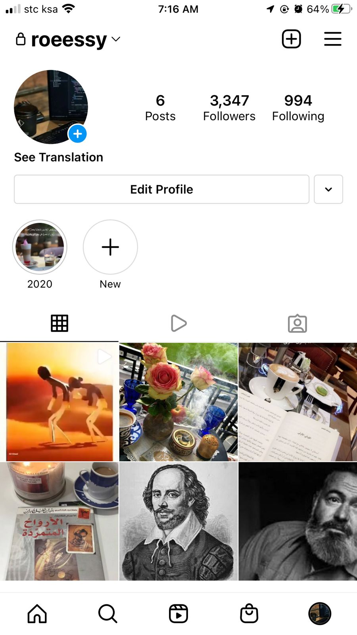
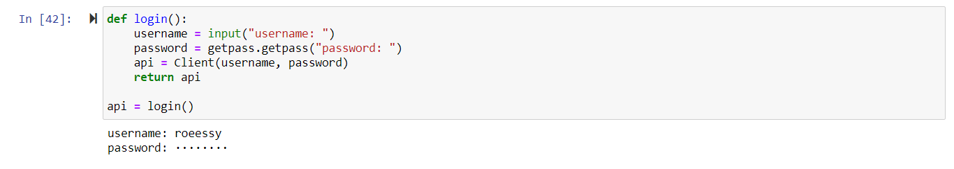
Fake account

Slide 13
Future work
Apply the model on Facebook.
Create an application to find real influencers.
Use other analyzes of classification such as the classification of followers by geographic region or age group.

Slide 14
Thank you, any Question?

